Slide 1
Bio &242 Unit 4 Labs 1 and 3

Slide 2
Histology Slides for the Endocrine System
Slides are presented in order of magnification
As you view the following slides, make sure you can accomplish these goals:
Can you identify the vessels and tissue layers observable on the slides?
Can you identify the specific structures or layers indicated by the numbered arrows or brackets?
At the end of a sequence, you will find the answers to the above for each vessel and layer

Slide 3
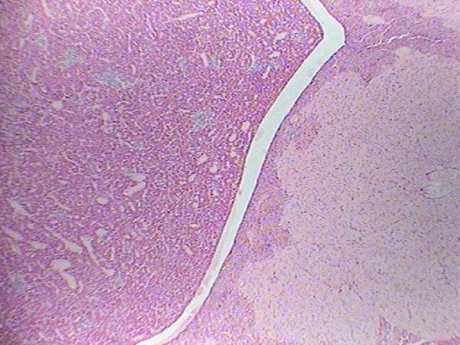
Gland? 100X
1
2

Slide 4
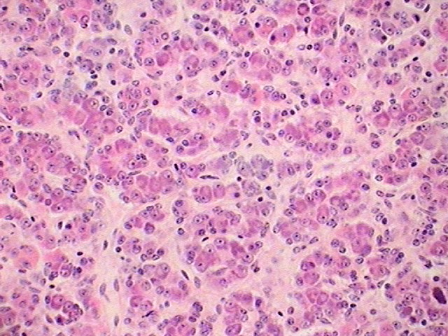
Specific part of gland? 400X
3
4
5

Slide 5
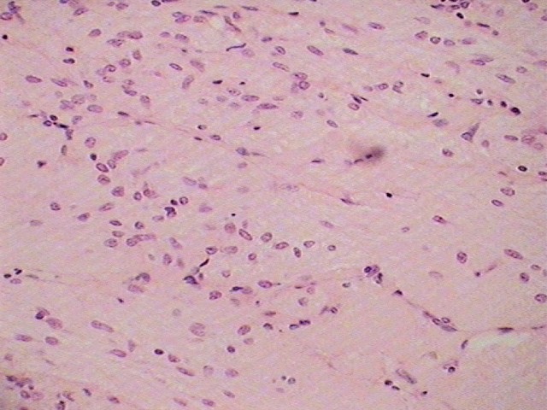
Specific part of gland? 400X
6
7

Slide 6
Pituitary Gland or Hypophysis
Slide #1
Anterior Pituitary Gland or Adenohypophysis
Posterior Pituitary Gland or Neurohypophysis
Slide #2
Acidophils
Basophils
Chromophobes
Slide #3
Axons of Hypothalamic neurosecretory cells
Pituicytes or supportive cells

Slide 7
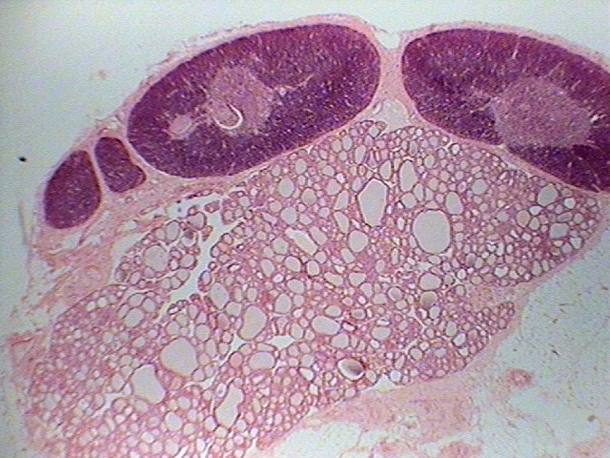
9
9
8
Glands? 40X

Slide 8
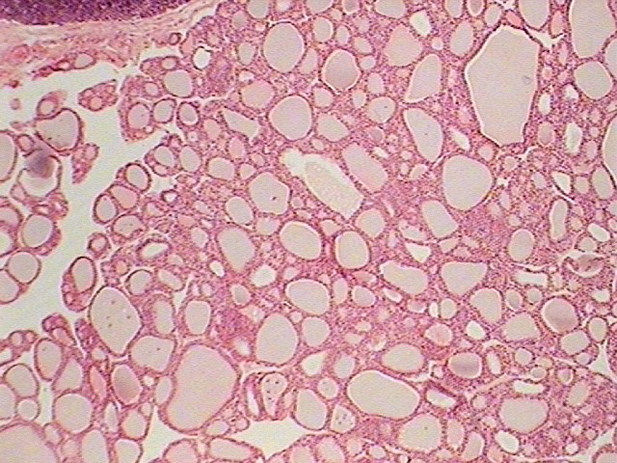
10
12
11
Gland? 100X

Slide 9
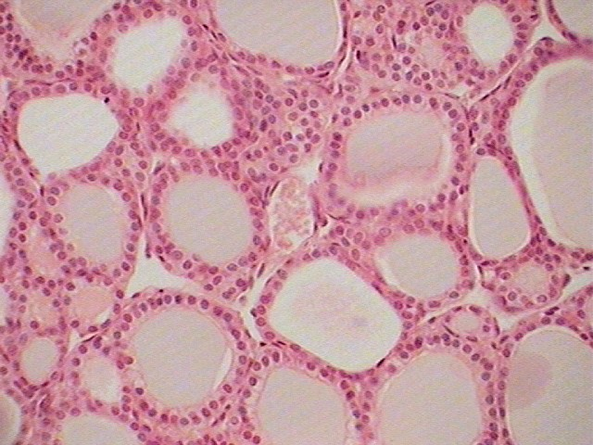
12
10
11
Gland? 400X

Slide 10
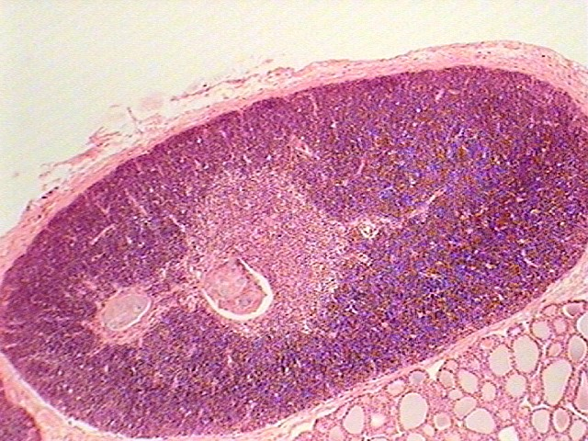
Glands 100X
9

Slide 11
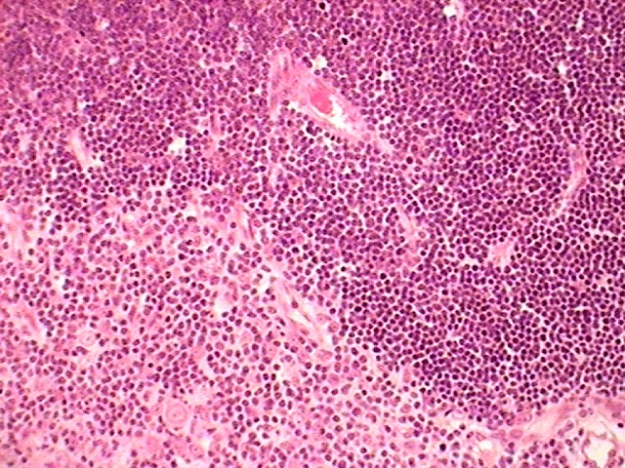
Gland? 400X
9

Slide 12
Thyroid and Parathyriod Glands
Slides #5, #6, #7, #8, and #9
Thyroid Gland
Parathyroid Glands (principal cells)
Thyroid follicle
Follicular Cells
Parafollicular Cells

Slide 13
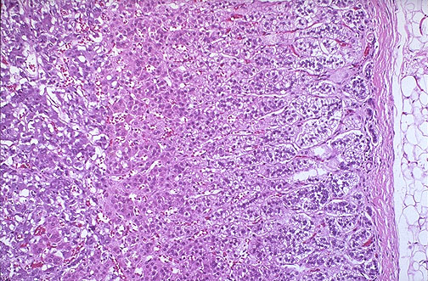
Gland? 100X, Cortex
17
16
15
14
13

Slide 14
Adrenal Gland
Slide # 11
Adrenal Cortex
Adrenal Medulla
Zona glomerulosa
Zona fasciculata
Zona Reticularis

Slide 15
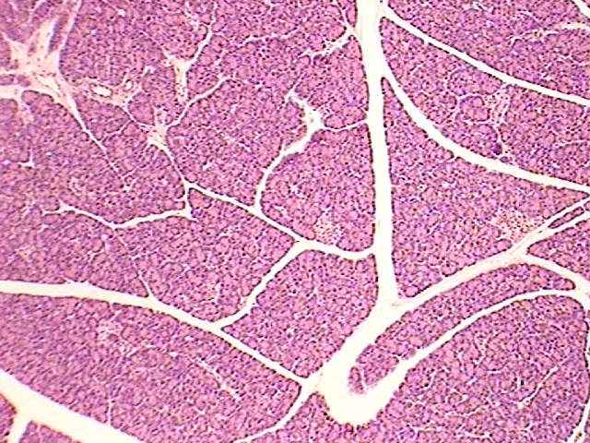
Gland? 100X
18

Slide 16
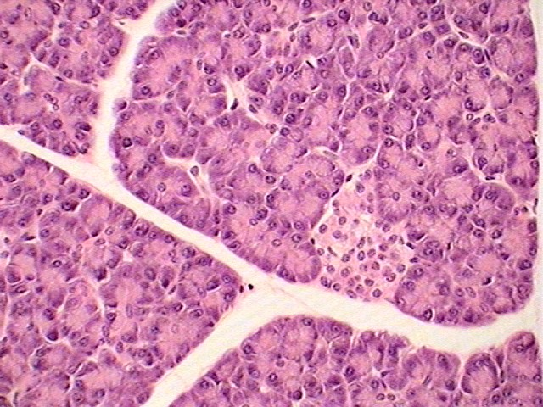
Pancreas 400X
18

Slide 17
Pancreas
18. Islet of Langerhans

Slide 18
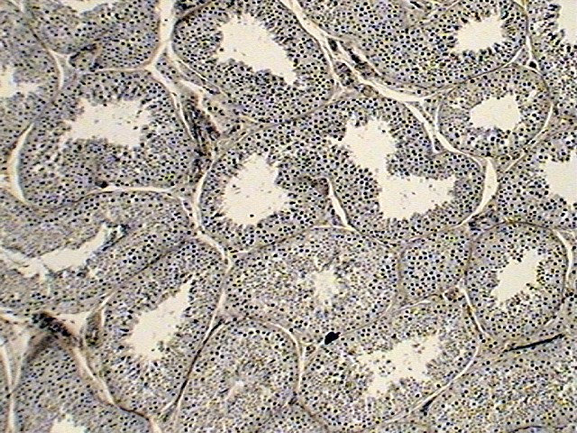
Gland or Organ? 100X
19

Slide 19
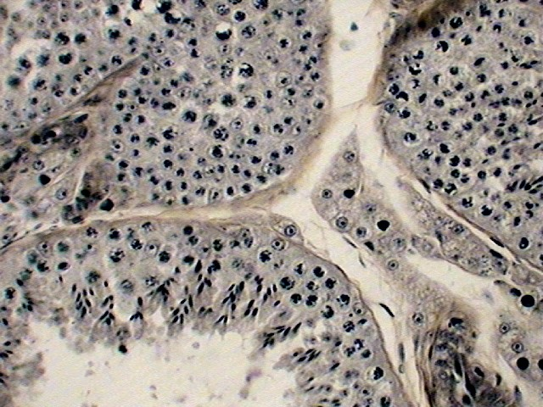
Gland or organ? 400X
23
21
20
22
24

Slide 20
Testes
Slide # 16
Seminiferous tubules
Slide # 17
Cells of Leydig or interstitial cells
Spermatogonium (2n stem cells)
Primary spermatocyte
Secondary spermatocytes
Late spermatids

Slide 21
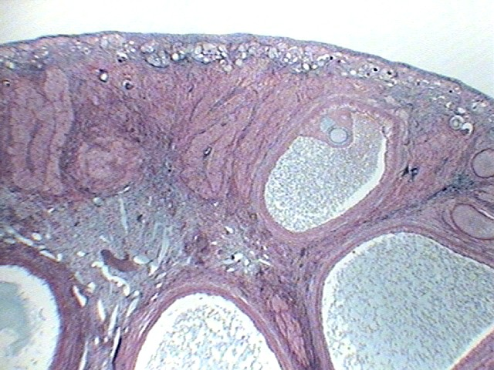
Organ? 40X
25
26
29
28
27

Slide 22
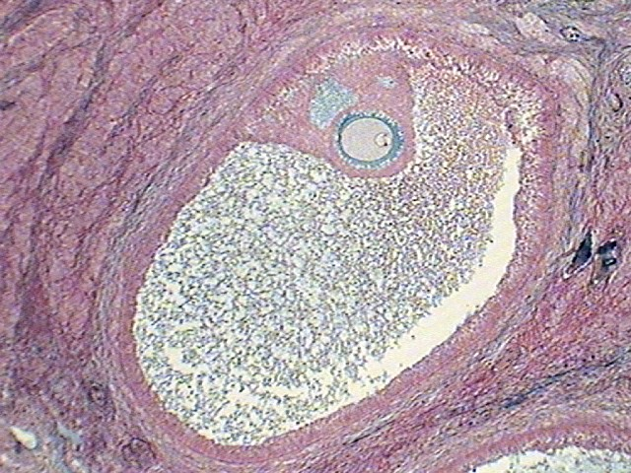
Organ and specific structure? 400X
30
31
28

Slide 23
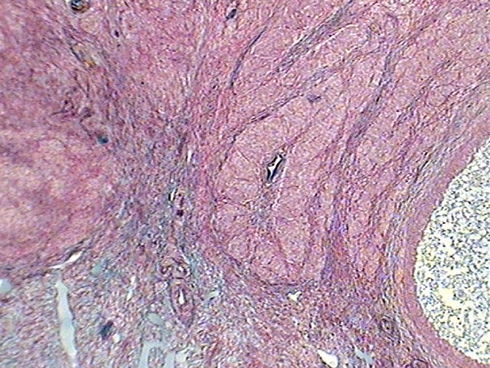
Organ and specific structure? 400X
32
29

Slide 24
Ovary
Slide #19, #20, and #21
Primordial follicles containing primary oocytes
Primary oocyte in a Graafian follicle
Antrum of the follicle
Follicular or granulosa cells
Corpus Luteum
Primary oocyte undergoing meiosis I (note two bands of chromosomes)
Zona pellucida
Old follicular antrium

